Slide 1



Parent Wellbeing Drop-in session
Mental Health Support Teams in Schools
Mental Health Support Team Info

Slide 2

What is an MHST?
We provide mental health support in schools across West Essex, with teams in Harlow, Epping Forest and Uttlesford.
We are funded by NHS England
We offer 1:1 interventions with parents of children struggling with challenging behaviour and/or anxious symptoms; mainly at home.
We also help to break the stigma around talking about mental health

Slide 3


CBT cycle - Hot cross bun
Our thoughts, emotions, how we feel in our bodies and what we do are all connected.
We may not realise it, but our thoughts change the way we feel & behave!
Behaviour
Thoughts
Physical Feelings
Emotions
Notes:
Introduce CBT cycle
Explain all sections and give examples.
Complete a hot cross bun as a group?
Situation – going to school?

Slide 4





How it works…
Behaviour
Thoughts
what we
do
what we
think
Physical Feelings
Emotions
what happens in our body
what we
feel
Notes:
Story Time with Lynn, "Ninjas Know the CBT Triangle“
The ABCs of CBT: Thoughts, Feelings and Behavior

Slide 5
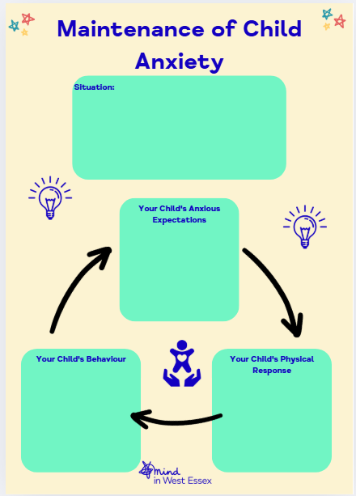
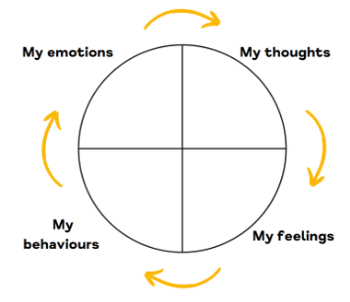

Cycle of Anxiety
Notes:
Children to add any others

Slide 6



What you might see….
Worrying or having negative thoughts
Experiencing lots of fears
Tearfulness
Difficulty concentrating
Difficulties sleeping
Becoming angry or irritable
Being clingy
Complaining of feeling unwell e.g. stomach aches, feeling sick, dizziness

Slide 7
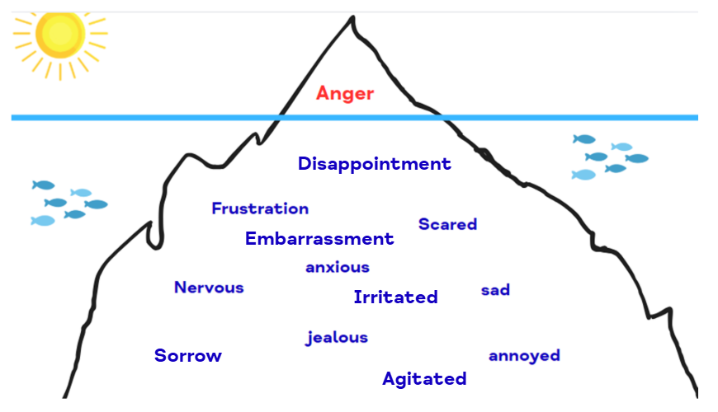
Anger iceberg

Slide 8

What you might see….
Having lots of angry outbursts or ‘tantrums’
Ignoring or refusing to follow requests
Verbal aggression e.g. shouting, swearing
Physical aggression e.g. hitting, biting
Damaging things
Excessive anger when not getting their own way

Slide 9

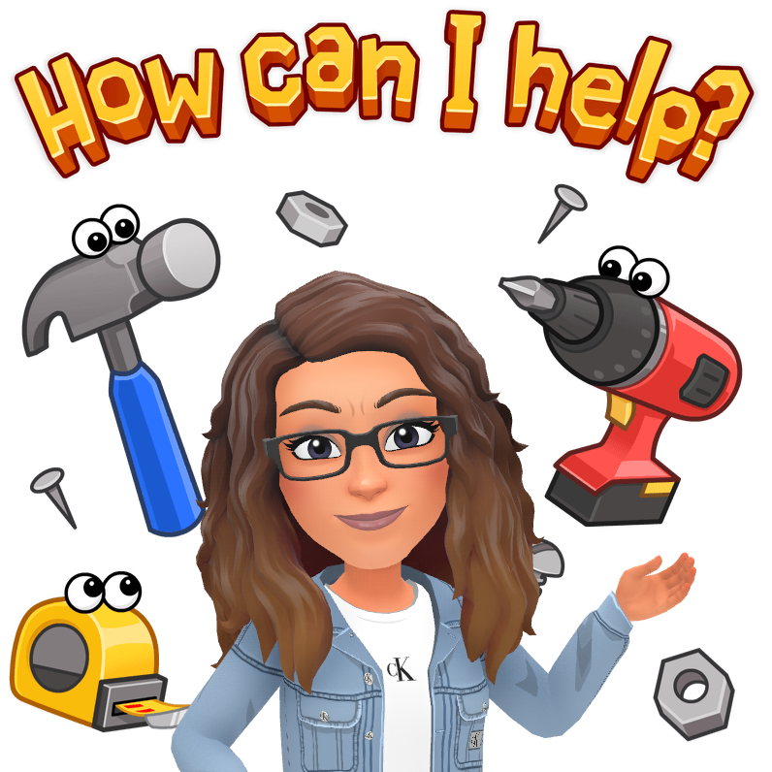
Please speak with your child’s class teacher or Pastoral Lead, Mrs Coole if you would like further support from the Mental Health Support Team (MHST).

Slide 10


Slide 11



