Slide 1


Welcome to Year 5
Willow and Pine

Slide 2

Pine Class – Mrs Roberts
Willow – Mrs Carruthers & Mrs Dupplaw
Learning Support Assistants:
Mrs Stimpson

Slide 3
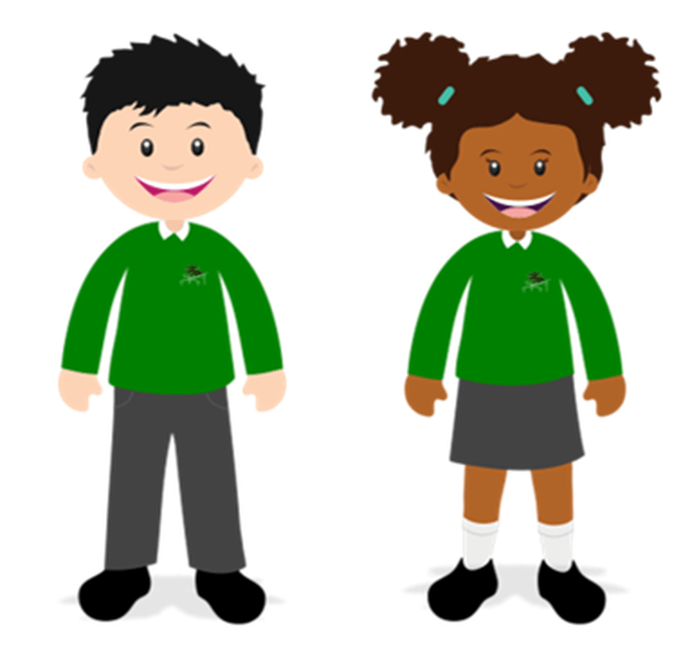
Uniform
Grey trousers or shorts, skirt or pinafore
White polo shirt* (EYFS & KS1), white shirt or blouse (KS2)
Bottle green sweatshirt or cardigan with or without school logo*
Tie (KS2 only) - available from the school office
White, black or grey socks, black or grey tights
Dark green fleece for outdoor wear* (optional)
Reversible waterproof jacket* (optional)
Simple gold of silver stud earrings.
Functional hairbands/ clips that are a discrete or
school colour
Summer variations:
Green gingham or striped dress/ shorts
School cap
Footwear:
In the interests of safety as well as appearance, please help us by providing secure and suitable footwear for school. Shoes and sandals should be:
low heeled
enclosed toes
black
Please make sure pupils have trainers for P.E. On occasion, we ask children to change shoes if their outdoor shoes are muddy.

Slide 4
A typical day in Willow and Pine Class:
-SODA
-Collective worship
-Maths
-Break
-English
-Guided Reading
-Lunch
-Topic/PE

Slide 5

P.E. Uniform
P.E. Kit:
Bottle green t-shirt with or without school logo
Black P.E. shorts with or without school logo
Plain black jogging bottoms
Trainers
Plain black jumper
Earrings MUST be removed.
P.E. days are Wednesday (outdoors) & Thursday. Swimming starts Thursday 18.9.2025).
Children are to come into school in their P.E. kit.
(Please note that these days may change as we have external coaches throughout the year).
Label ALL items please!

Slide 6
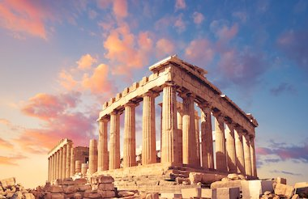
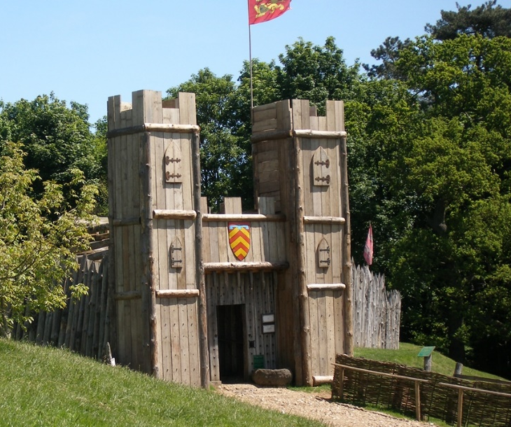
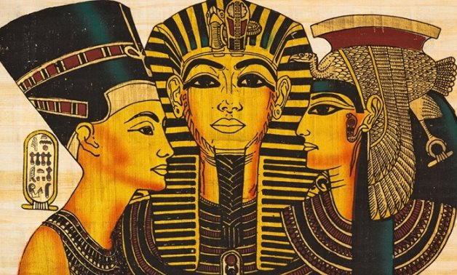
Topics
We have some excellent topics to look forward to in Year 5 this year:
Ancient Greece & Renewable energy (Autumn)
Local history & independent fieldwork study(Spring)
Ancient Egypt & the desert habitat (Summer)

Slide 7


Science
Over the year we will cover a range of exciting topics including:
Living things and their habitats
Space
Properties and changes of materials
Forces
Animals, including humans
In summer, we will be exploring the changes humans go through as they age, including puberty.
So… Be prepared for the questions!

Slide 8

Class Guided Reading
This year, Guided Reading will
take the form of Class Guided
Reading.
Our first core text will be ‘Who Let The Gods Out‘. We will be interspersing this with various others texts, all centred around Greek mythology, in order to most effectively teach the necessary skills for reading.

Slide 9



Class Guided Reading
Later in the year, we will study a modernised version of Romeo and Juliet, Mummies Unwrapped and Room 13.

Slide 10

Homework
-Times Table Rockstars
Reading daily
Spellings (weekly test)
ATOM learning

Slide 11

Homework - Reading
Alongside topic and spelling homework, reading will be a necessity. The children will be expected to read everyday at home and will use a class Padlett to create book reviews.
Children will begin the year continuing on their previous accelerated reader level range.
They will take a quiz termly to reassess levels and check progress.

Slide 12

Homework - Spellings
-This year, spelling words will be sent home to practise alongside being taught and practised in school.
- There will be ten spellings a week to learn:
Five words from the Statutory Spelling Lists
Five words following the rule taught in school.
-These will be stuck in the purple spelling log and assessed the following week.
Thursday to Thursday

Slide 13


Slide 14
Atom
Atom homework will be assigned every Friday and will be linked to work we are doing in class.
It is an expectation that Atom work is completed every week in English and maths. Please speak to your class teacher if this will be an issue.
https://app.atomlearning.com/

Slide 15
Handwriting
From Reception through to Year 6 we use the cursive handwriting style.
The aim of the style is to increase fluency and improve speed and presentation.
You will have access to the
website at home:
Username: else
Password: nham
http://www.letterjoin.co.uk

Slide 16

Social Media

Slide 17

Social media
Set boundaries with age restricted apps
Set time restrictions on screen use
Monitor closely for inappropriate content or conversations.
Be aware of cyber bullying
Visit the NSPCC website for further reading.

Slide 18
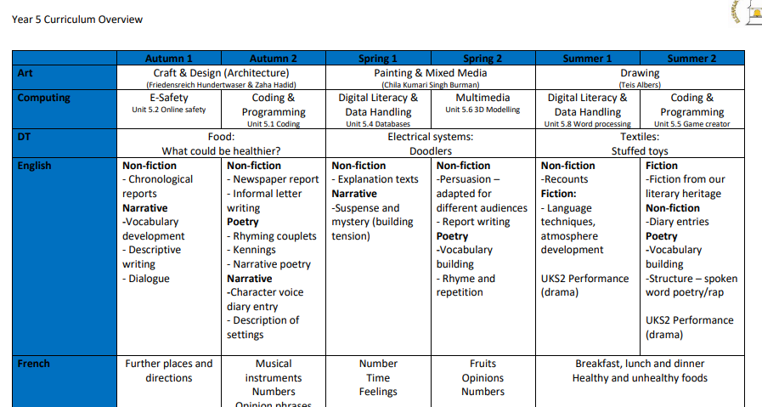
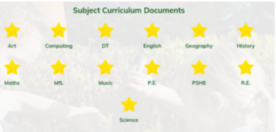
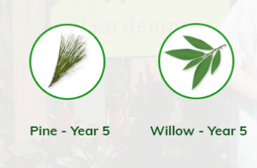
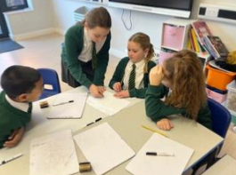
Our school website
School website

Slide 19
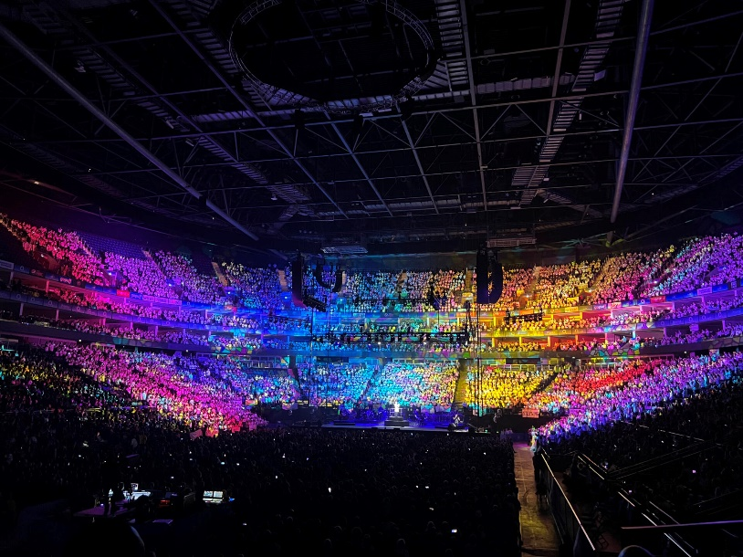
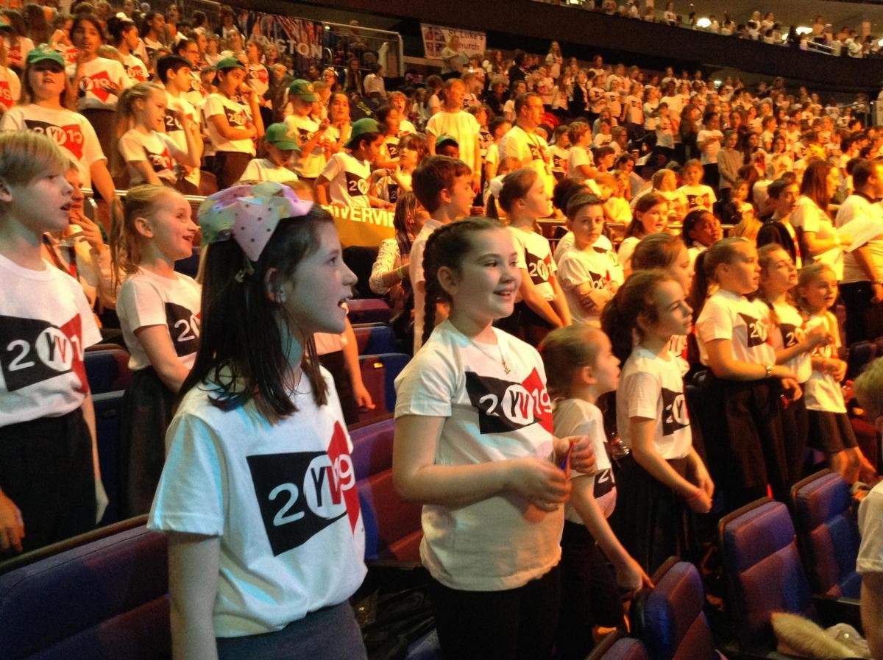
Young Voices Concert
As part of their music curriculum, Year 5 are going to performing in a huge concert at the O2 Arena in London. Practise the songs at home by looking for ’Young Voices Music Pack 2026’ on Spotify.
Date: 19th January
Details: Orders by 15th September
Payment: Payments to be sent by 29th September
Young Voices Video

Slide 20


What needs to come to school daily:
-Water bottle
-Reading record
-Reading book
-A snack (fruit, veg or cereal bar)

Slide 21


Thank you for coming.
Any questions?
The school website, Parentmail and weekly Newsletters provide all important dates and details.

