Slide 1
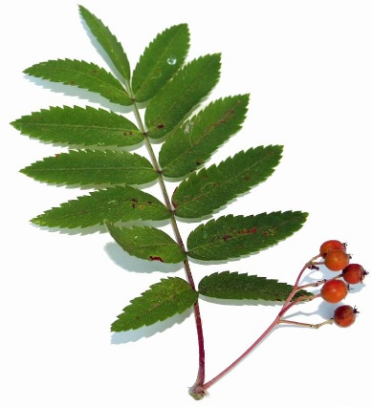

Welcome to
Meet the Teacher Evening
Teachers
Mrs Channing, Mrs Brazier, Mrs Edwards
Cover teachers
Mrs Samuel, Miss Sturrock
Support staff
Mrs Osborne, Mrs Burt

Slide 2
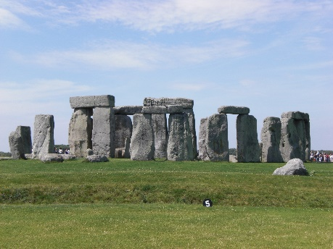
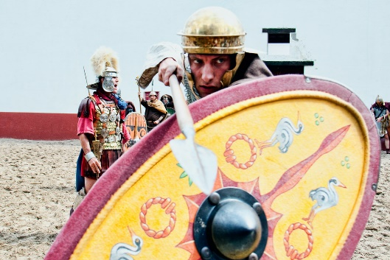
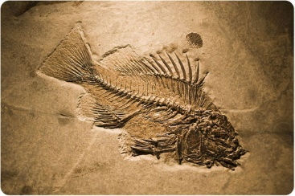
Exciting topics to look forward to in Year 3…
Stone Age and Iron Age
The Roman Empire
The Mayans
Forces and magnets
Rocks and fossils
Central America
Volcanoes
Polar environments
Construction
Philosophy
Also, this year, your child will start to learn French!

Slide 3
A typical day in Year 3:
Early morning SODA work (grammar, spellings, maths, comprehension)
Guided Reading
English
Break time at 10.45am
Maths
Lunch time at 12.30pm
Foundation subject (science, R.E. geography, French, P.E. history, P.S.H.E. computing, music)
Collective Worship

Slide 4


P.E.
Friday morning/afternoon: Indoor P.E
Tuesday afternoon: Outdoor games.
Please ensure your child comes in wearing clothes that are weather appropriate, warm joggers and a jumper for the coming winter months and shorts and tshirt for the spring and summer.
Please name all items of clothing.
If your child does the additional Gymnastics sessions on a Wednesday, please ensure that they are dressed in PE kit on that day.
No earrings for P.E. lessons. Please remove them at home on P.E days.
Notes:
No taped ears. Can be taken out in school but child must be able to do it independently. Warm kit in school as we will be out in all weather.
Messages sent in via school office if cannot take part for any reason.

Slide 5
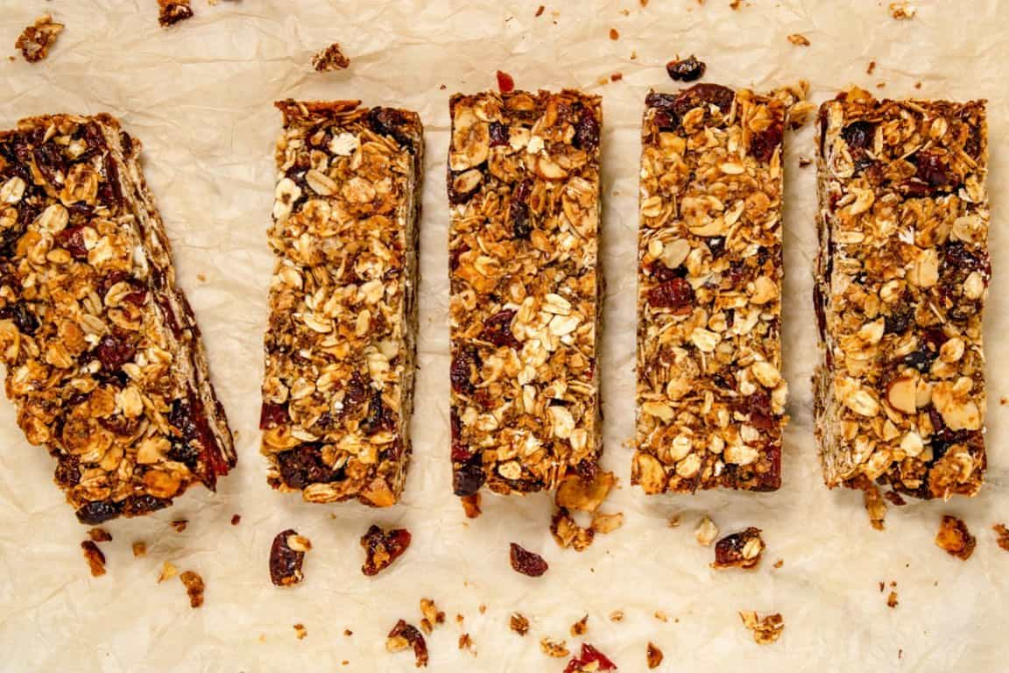
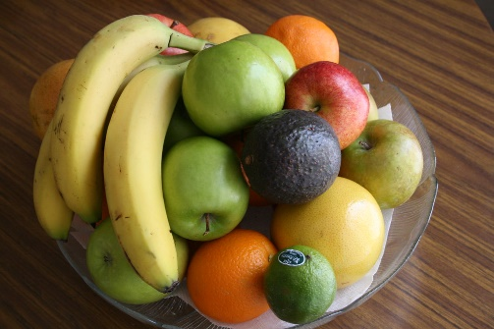
Snacks and water
Please provide a snack for your child to keep in their drawer. Key stage 2 do not get free fruit.
Fruit or vegetables are preferred, however cereal bars (no chocolate) are allowed.
We are a nut free school.
A filled, named water bottle should be brought in each day. No cordial or juice please.

Slide 6
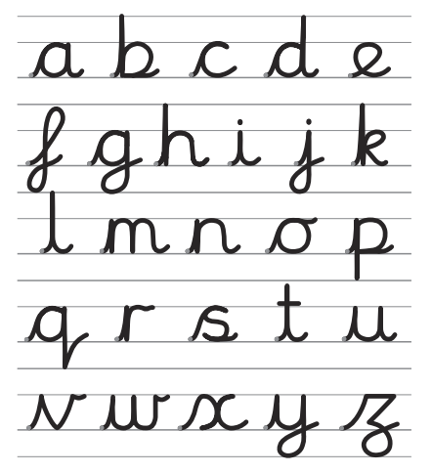
Handwriting
From Reception through to Year 6 we use the cursive handwriting style.
The aim of this style is to increase fluency and improve speed and presentation.
You will have access to the
website at home:
Username: else
Password: nham
If there are any problems with access at home, please let us know.
http://www.letter-join.co.uk

Slide 7
More ways to support your child
Read with them regularly
Ask them about their learning
A good night’s sleep and a healthy snack for school!
Help them to practise their times tables and spelling every week
Monitor time online - e-safety

Slide 8
Other information
Please check your parent mail regularly as important messages are sent this way.
Please keep up to date with information shared on our school website and the weekly newsletters.
Toys and special belongings should not come into school.
Correct uniform must be worn; no hoop/sleeper earrings and hairbands must be functional and discrete in appropriate colours.
Pencil cases should be functional and not a distraction.
The Hub Team are having a coffee morning on Thursday 17th September at 8.45. Come along to meet Kirsty Rose, an autism specialist who will be talking about how to support your child and any concerns you may have.
One Plan evening is Wednesday 14th October.

Slide 9
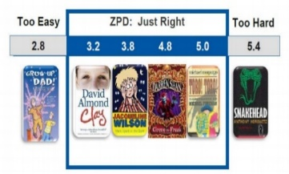

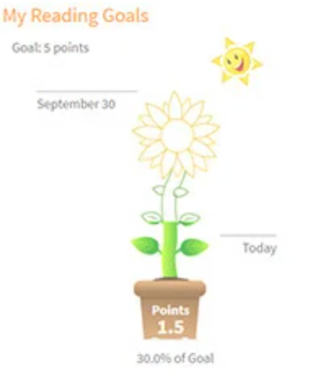
Renaissance Reading
In School
Star Reading is a computer-based assessment used to determine your child's reading level. It continually adjusts the difficulty of questions based on your child's responses
This then gives our child a reading age which is used to allocate a ZPD (zone of proximal development) range. This indicates the range of books that are suitable for your child’s reading level.
This ensures that your child is choosing books which support progression and offer challenge while not reducing confidence or enjoyment.
At Home
Your child should complete an Accelerated Reader quiz after finishing every book.
Quiz results do not immediately change a child's reading level or ZPD, but regular quizzing builds confidence, develops comprehension skills, and helps children become familiar with the quiz format before their next STAR Reading Test.
To ensure an accurate assessment of reading ability, all quizzes should be completed without adult support and on books your child has read independently. Shared reading books, such as bedtime stories, should not be quizzed.
Children grow virtual flowers by successfully completing quizzes. For every flower grown, children earn 5 marbles celebrating their reading effort.
Notes:
All the children have been allocated a ZPD range: this is the range of books that are suitable for your child’s reading level. This ensures the children are choosing books which support progression and offer challenge while now reducing confidence or enjoyment. The children can choose a book within this range from the school library during visits
The quizzes create a flower- each flower = 5 marbles
And word millionaire- certificate
Indicate them to the guide and talk through the steps

Slide 10
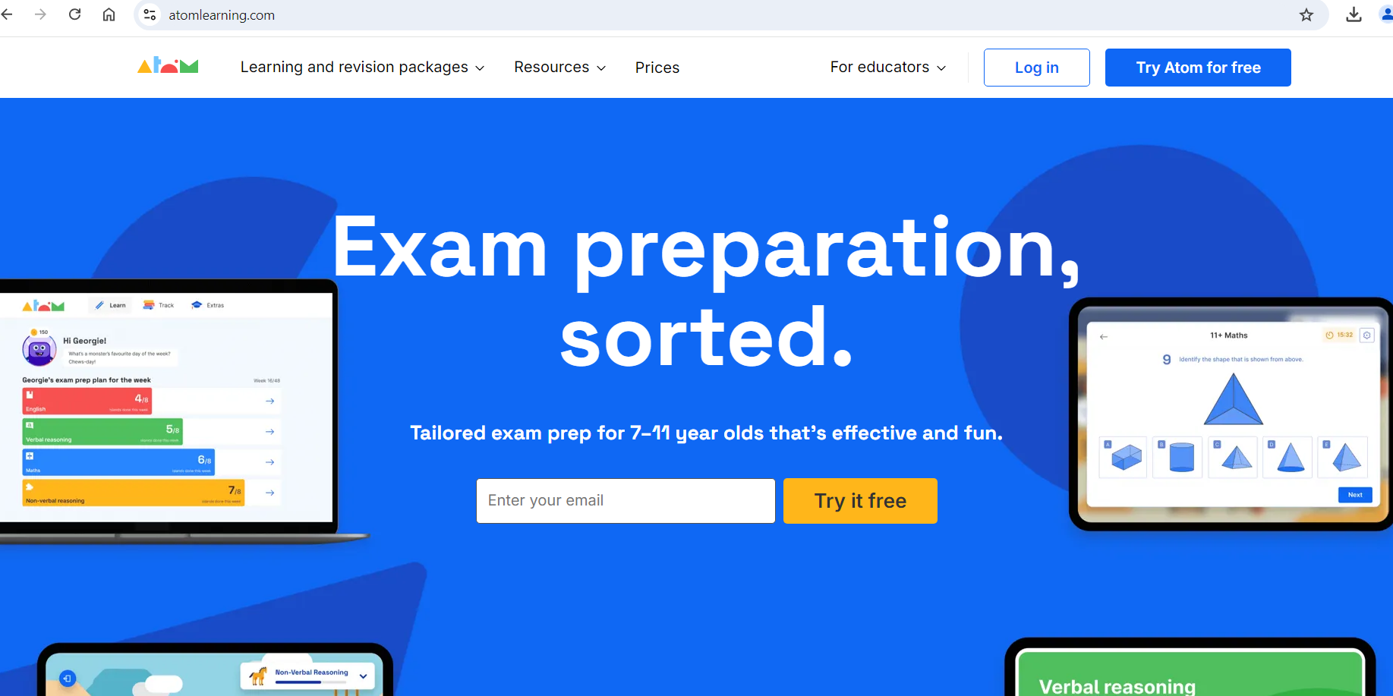
Atom Learning
Notes:
Homework includes: TTRS, reading, spelling, ATOM

Slide 11
Our Website
Curriculum | Elsenham C. of E. Primary School

Slide 12
E-Safety – 2 Johns
Home - eSafety Training

Slide 13

Social media
Set boundaries with age restricted apps
Set time restrictions on screen use
Monitor closely for inappropriate content or conversations.
Be aware of cyber bullying
Visit the NSPCC website for further reading.

Slide 14
Thank you for coming!
We look forward to working alongside you this year.
Are there any questions?

