Slide 1


Welcome to Year 5
Willow and Pine

Slide 2

Pine Class – Mrs Sipple
Willow – Mrs Carruthers & Mrs Dupplaw
Learning Support Assistants:
Mrs Stimpson and Mrs Roberson

Slide 3

Uniform
Grey trousers or shorts, skirt or pinafore
White shirt or blouse
Bottle green sweatshirt or cardigan with or without school logo
Tie - available from the school office
White, black or grey socks, black or grey tights
Simple gold or silver stud earrings.
Functional hairbands/ clips that are a discrete or
school colour
Summer variations:
Green gingham or striped dress/ shorts
School cap
Footwear:
Shoes should be:
enclosed toes
Black
Please make sure pupils have trainers on for P.E. On occasion, we ask children to change shoes if their outdoor shoes are muddy.

Slide 4
A typical day in Willow and Pine Class:
-SODA
-Guided Reading
-English
-Break
-Maths
- Topic
-Lunch
-Topic/P.E.
-Collective worship

Slide 5

P.E. Uniform
P.E. Kit:
Bottle green t-shirt with or without school logo
Black P.E. shorts with or without school logo
Plain black jogging bottoms
Trainers
Plain black jumper
Earrings MUST be removed.
P.E. days are Wednesday (outdoors) & Thursday. Swimming starts Thursday 17.9.2025).
Children are to come into school in their P.E. kit.
(Please note that these days may change as we have external coaches throughout the year).
Label ALL items please!

Slide 6
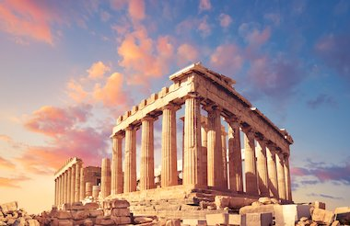
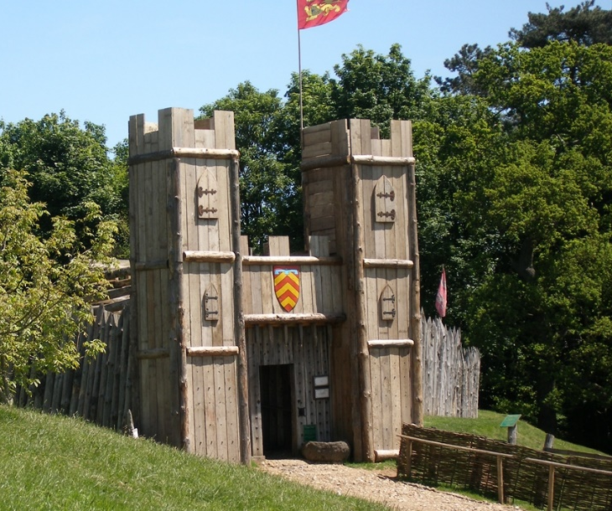

Topics
We have some excellent topics to look forward to in Year 5 this year:
Ancient Greece & Renewable energy (Autumn)
Local history & independent fieldwork study(Spring)
Ancient Egypt & the desert habitat (Summer)

Slide 7


Science
Over the year we will cover a range of exciting topics including:
Living things and their habitats
Space
Properties and changes of materials
Forces
Animals, including humans
In summer, we will be exploring the changes humans go through as they age, including puberty.
So… Be prepared for the questions!

Slide 8

Class Guided Reading
This year, Guided Reading will
take the form of Class Guided
Reading.
Our first core text will be ‘Who Let The Gods Out‘. We will be interspersing this with various others texts, all centred around Greek mythology, in order to most effectively teach the necessary skills for reading.

Slide 9



Class Guided Reading
Later in the year, we will study a modernised version of Romeo and Juliet, Mummies Unwrapped and Room 13.

Slide 10

Homework
-Times Table Rockstars
Reading daily
Spellings (weekly test)
ATOM learning

Slide 11

Homework - Reading
Alongside topic and spelling homework, reading will be a necessity. The children will be expected to read everyday at home and will use a class Padlett to create book reviews.
Children will begin the year continuing on their previous accelerated reader level range.
They will take a quiz termly to reassess levels and check progress.

Slide 12

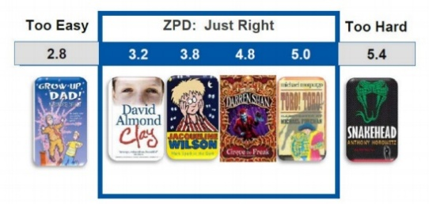
Renaissance Reading
In School
Star Reading is a computer-based assessment used to determine your child's reading level. It continually adjusts the difficulty of questions based on your child's responses
This then gives our child a reading age which is used to allocate a ZPD (zone of proximal development) range. This indicates the range of books that are suitable for your child’s reading level.
This ensures that your child is choosing books which support progression and offer challenge while not reducing confidence or enjoyment.
Notes:
All the children have been allocated a ZPD range: this is the range of books that are suitable for your child’s reading level. This ensures the children are choosing books which support progression and offer challenge while now reducing confidence or enjoyment. The children can choose a book within this range from the school library during visits
The quizzes create a flower- each flower = 5 marbles
And word millionaire- certificate
Indicate them to the guide and talk through the steps

Slide 13
Renaissance Reading
At Home
Your child should complete an Accelerated Reader quiz after finishing every book.
Quiz results do not immediately change a child's reading level or ZPD, but regular quizzing builds confidence, develops comprehension skills, and helps children become familiar with the quiz format before their next STAR Reading Test.
To ensure an accurate assessment of reading ability, all quizzes should be completed without adult support and on books your child has read independently. Shared reading books, such as bedtime stories, should not be quizzed.
Notes:
All the children have been allocated a ZPD range: this is the range of books that are suitable for your child’s reading level. This ensures the children are choosing books which support progression and offer challenge while now reducing confidence or enjoyment. The children can choose a book within this range from the school library during visits
The quizzes create a flower- each flower = 5 marbles
And word millionaire- certificate
Indicate them to the guide and talk through the steps

Slide 14
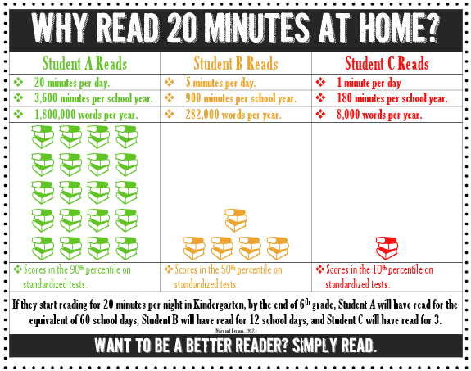

Slide 15

Homework - Spellings
-This year, spelling words will be sent home to practise alongside being taught and practised in school.
- There will be ten spellings a week to learn:
Five words from the Statutory Spelling Lists
Five words following the rule taught in school.
-These will be stuck in the purple spelling log and assessed the following week.
Thursday to Thursday

Slide 16
Atom
Atom homework will be assigned every Friday and will be linked to work we are doing in class.
It is an expectation that Atom work is completed every week in English and maths. Please speak to your class teacher if this will be an issue.
https://app.atomlearning.com/

Slide 17
Handwriting
From Reception through to Year 6 we use the cursive handwriting style.
The aim of the style is to increase fluency and improve speed and presentation.
You will have access to the
website at home:
Username: else
Password: nham
http://www.letterjoin.co.uk

Slide 18
Fidgets
Following a review of classroom practice and educational research, we are making some changes regarding Fidget Toys. The first change is to refer to these sensory aids as Fidget Tools or Concentration Aids instead of toys.
Over recent months, we have found that “fidget toys” are increasingly:
a source of distraction rather than supporting learning and focus
shared between children
becoming toys during lessons
interrupting concentration
leading to disagreements between pupils
Our decision is supported by current research, which shows there is no strong evidence that fidget toys improve attention, behaviour or learning for most pupils. Some clinical studies show they can even become a distraction, and they are not recommended as an evidence-based intervention for ADHD.
We therefore appreciate your support in ensuring fidget tools do not come into school.
If your child had previously been allowed a fidget tool and you believe they still need it, please contact Mrs Cowell on send@elsenham.essex.sch.uk to discuss this.

Slide 19

Social media and screen time

Slide 20

Screen Time
Set boundaries with age restricted apps
Set time restrictions on screen use
Monitor closely for inappropriate content or conversations.
Be aware of effects on the brain and development
Be aware of cyber bullying
Visit the NSPCC website for further reading.
https://www.youtube.com/watch?v=ndOB-vXwXxM

Slide 21
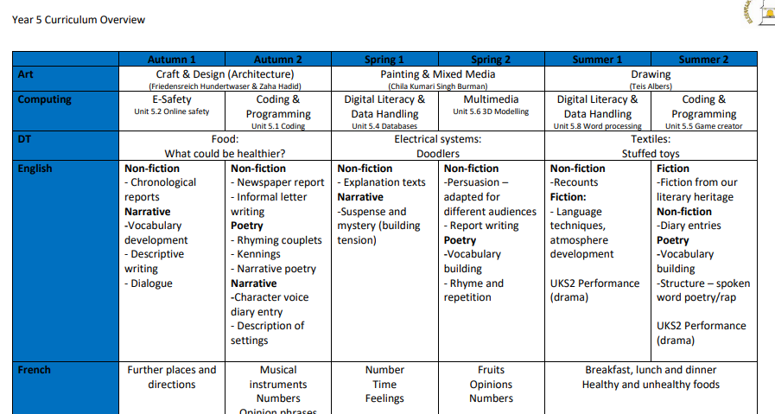
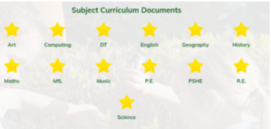
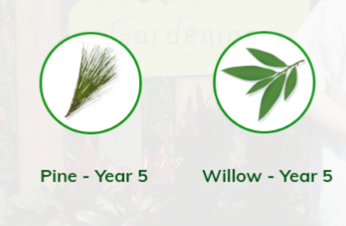
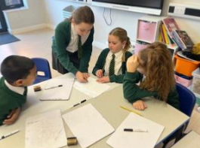
Our school website
School website

Slide 22
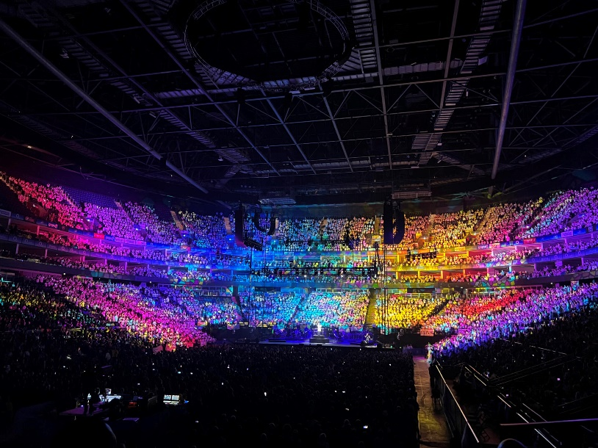
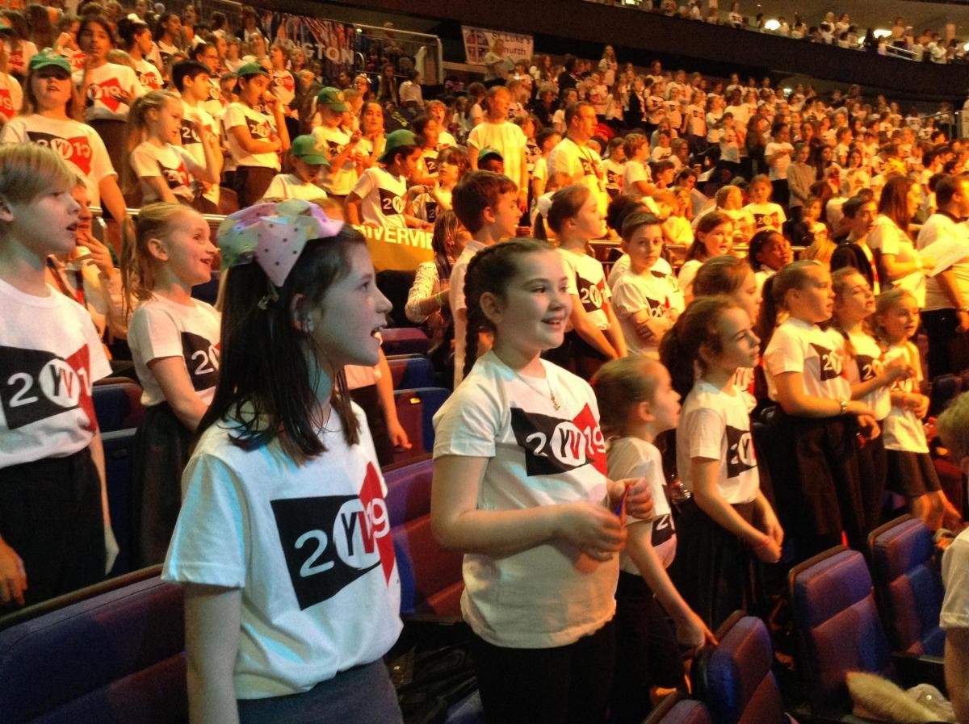
Young Voices Concert
As part of their music curriculum, Year 5 are going to performing in a huge concert at the O2 Arena in London. Practise the songs at home by looking for ’Young Voices Music Pack 2027’ on Spotify.
Date: 19th January
Details: https://yvmusicroom.com/auth/parent/journey/welcome
Parents must join the parent portal to book tickets or order t-shirts.
Payment: Payment for the coach to be sent by 29th September
Young Voices Video

Slide 23

The hub team are having a coffee morning next week at 8.45am on Thursday 17th September.
This will be an opportunity to meet our new pastoral lead.
We are also having a workshop from Kirsty Rose an autism specialist who will be talking about supporting children with anxiety and social communication difficulties. Kirsty also works with families and will be able to talk about the services she offers.
Everybody is welcome.

Slide 24


What needs to come to school daily:
-Water bottle
-Reading record
-Reading book
-A snack (fruit, veg or cereal bar)

Slide 25


Thank you for coming.
Any questions?
The school website, Parentmail and weekly Newsletters provide all important dates and details.

