Slide 1
Year One
Meet the Teachers 2026
LSAs
Miss Verlander
Chestnut Teacher
Mrs Roberts
Beech Teacher
Miss Monger
Miss Sturrock
Mrs Mallet
Mrs Brown
Mrs Glover
Notes:
Meghan

Slide 2
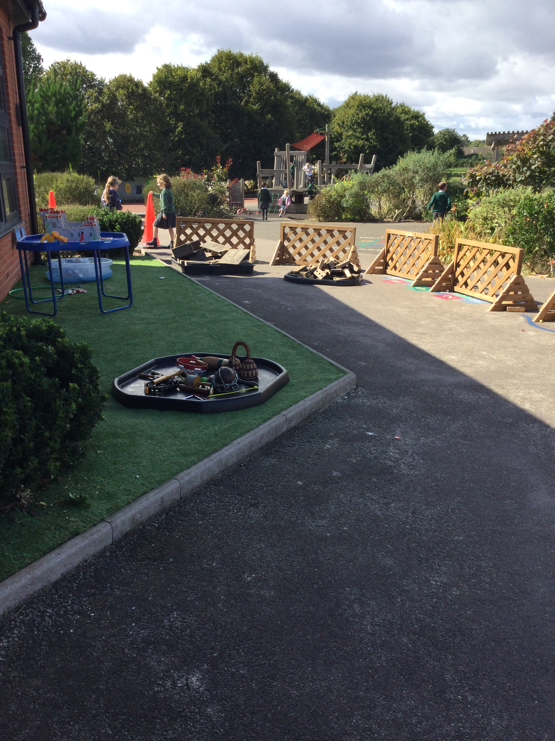
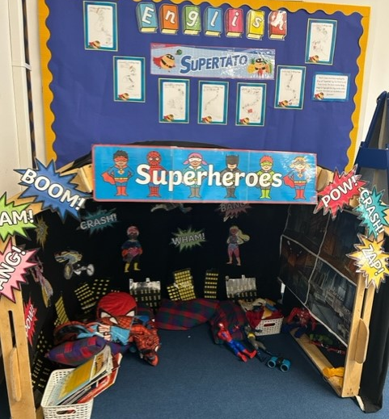
Transition from EYFS to Year 1
Focus on settling in, behaviour and getting to know each other
Continuous and Enhanced provision opportunities throughout the day.
Fluidity into the outdoor classroom
Forest School
Notes:
Meghan

Slide 3

P.E.
Indoor P.E. is on a Thursday
Outdoor P.E. is on a Wednesday
Children need to come into school in their named P.E. kit (green top, black shorts/joggers and jumper/fleece
No earrings for P.E. lessons. Please remove them at home or ensure your child can remove them themselves.
Notes:
Alice

Slide 4


Forest School
Every Wednesday Year 1 pupils will be taking part in outdoor learning in our Forest School.
Why we love Forest School:
- Improved mental health and wellbeing
- Fresh air and space to explore
It promotes self-esteem
Creativity is nurtured
Supported risk-taking leads to greater independence
Forest School and P.E. Clothes
Notes:
Meghan

Slide 5



Behaviour
Verbal praise
Transformer award
Celebration assembly
Praise notes
Headteacher awards
Stickers
Marbles
Class reward jar
Notes:
Alice

Slide 6
A typical day in Year One
Continuous and enhanced provision runs alongside our curriculum.
Early morning SODA work
RWI
English or Maths
Break time at 10.20am
Maths or English
Lunch time at 12pm
Foundation subject
  (science, R.E. geography, P.E. history, P.S.H.E. computing, music)
Collective Worship (Assembly)
Home Time
Notes:
Alice

Slide 7
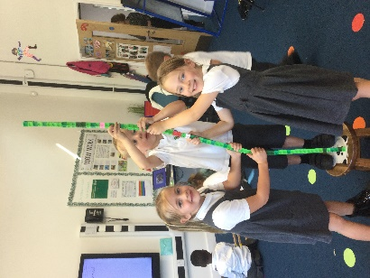
Enhanced Provision
Formal lesson inputs
Purposeful and engaging learning environment, indoors and out, where children can explore and learn throughout the day.
Teachers plan and resource opportunities, with a focus on consolidating and deepening knowledge and skills covered within our curriculum.
Children have FUN!

Slide 8
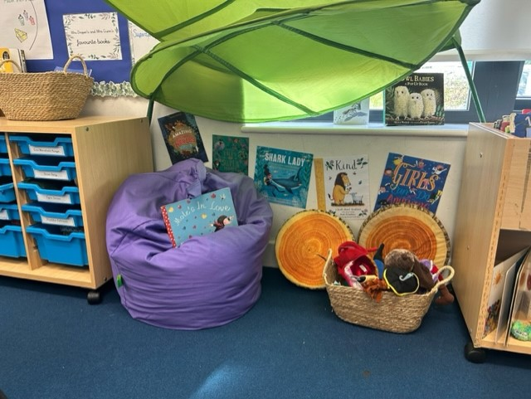

Reading
All reading levels were thoroughly assessed during the Summer term in EYFS.
The children have been grouped and have daily RWI phonics sessions, to match their ability.
Notes:
Rachel

Slide 9

Reading at home
Home reading expectations.
Books your child will be bringing home:
One Read, Write, Inc. book that the children have practised reading in school.
One Read, Write, Inc. book that the children have not read before.
One ‘book bag’ book for you to read and your child to enjoy.
Children should read at home everyday.
An adult should record the title of the book, pages read with a short comment and signature.
A list of statutory spelling words for Year 1 are on our school website - can your child spot any of these words in their reading book?
If you have any questions about reading expectations within school, please come and see your child’s teacher.
Notes:
Rachel

Slide 10
Reading buddies
Year 1 pupils will have reading buddies and they will be the same ones they had last year!
Our first reading buddy session is next week.
Notes:
Rachel

Slide 11
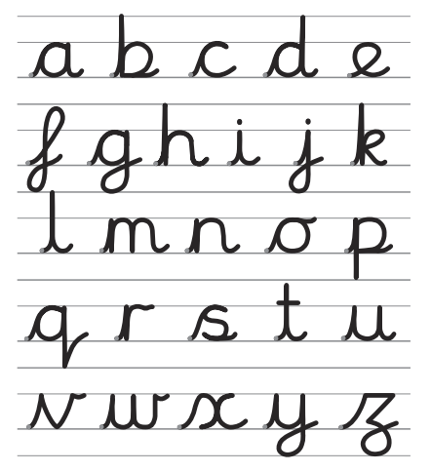
Handwriting
We write in a cursive style.
This will increase fluency
and improve presentation.
www.letterjoin.co.uk
Username: else
Password: nham
Notes:
Meghan

Slide 12



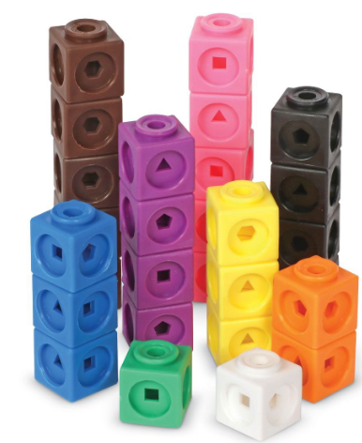
Maths
Maths is taught practically using a variety of apparatus.
Number recognition and formation
Deep understanding of numbers to 100
Ordering numbers (out of context)
Counting to 100 and beyond
Adding and subtracting
Number bonds (ways to make 10, and then 20)
Odd and evens
Doubles and sharing (fractions)
Counting in 2s, 5s and 10s
Notes:
Alice

Slide 13
Time to Talk
Every child will have the opportunity to share something that is special or important to them, with their class. This could be a photo, certificate, object (no valuables please).
We will let you know in advance when it is your child’s time to talk. Please rehearse at home, so that children feel confident to speak aloud to their class.
Notes:
Rachel

Slide 14






Our topics
Superheroes
Dinosaurs
The Great Fire of London
Deep in the Jungle
Moon Zoom
Explorers
Notes:
Meghan

Slide 15

Enrichment
Pantomime (in school)
The Great Fire of London Day
Wonderdome
Author visits
Sports trip
Curriculum themed days
Year 1 in the space dome!
Notes:
Meghan

Slide 16
How to help at home
Ask your child about their learning every day! Can they name 3 things they enjoyed?
Children should read at home on a daily basis
Encourage your child to take part in the weekly
reading raffle
Letter formation- cursive!
Practise number formation and then move on to writing numbers in words
Topic homework every half term
Purple Mash and Numbots
Notes:
Alice

Slide 17




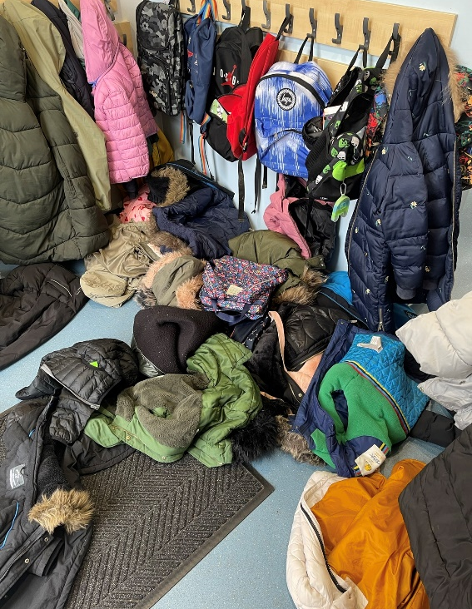
What needs to come to school daily:
Water bottle
Reading record
Reading books
Please avoid backpacks so that our cloakrooms don’t look like this…
Notes:
Alice

Slide 18
Other information
Visit our school website: www.elsenham.essex.sch.uk
Send Email:
send@elsenham.essex.sch.uk
Please check your parent mail regularly as important messages are sent this way.
Keep up to date with information shared on our school website and the weekly newsletters.
Toys and special belongings should not come into school.
Correct uniform must be worn; no hoop earrings, and hairbands must be functional and discrete in school colours.
Notes:
Rachel

Slide 19
Thank you for coming!
We look forward to working alongside you, and are excited for a fantastic year with your lovely children.
Notes:
Rachel

