Slide 1
Welcome to
Year 2
Silver Birch and Cedar Class
Notes:
A

Slide 2
Staffing
Silver Birch
Mrs Gunn
Cedar
Mrs Jackson
LSAs
Miss BC
Miss Taylor
Mrs Glover
Mrs Billcliffe
Miss Lowe
Notes:
A

Slide 3
In Year 2
Settling in
We continue to build on prior learning and develop children’s understanding from Year 1.
We aim to nurture happy, confident, independent learners.
Notes:
A

Slide 4
Enhanced Provision
“Play is one of the main ways that children really consolidate their learning. The way we really make our skills permanent and enriched and highly developed, is often through our play experiences.”
Doris Bergen, Department of Educational Psychology
Notes:
S

Slide 5
Enhanced Provision
Formal lesson inputs
Purposeful and engaging learning environment, indoors and out, where children can explore and learn throughout the day.
Teachers plan and resource opportunities, with a focus on consolidating and deepening knowledge and skills covered within our curriculum.
Children have FUN!
Notes:
S

Slide 6
A typical day in Year 2:
Morning activity SODA (spelling, handwriting, number facts)
RWInc
English, Maths
Curriculum subjects
(P.E., R.E., Art, D.T., History, Geography, Forest School)
Collective Worship (assembly)
In addition, we also teach handwriting, spelling and take part in guided reading lessons each week.
Notes:
S

Slide 7
P.E. and Forest School
Cedar | Silver Birch
Tuesday – P.E. kit worn to school. Friday – Forest school clothes worn to school (P.E. day) | Thursday – P.E. kit worn to school. Friday – Forest school clothes worn to school (P.E. day)
Forest school clothes should be old clothes that are dark in colour.
Hair should be tied back as normal.
Earrings removed for P.E. days and forest school days.
Notes:
A

Slide 8
Homework and Reading Expectations
Topic Homework
Reading records – please read with children as often as possible but at least three times per week. Children can then be entered into reading raffle.
Spellings – sent out on Mondays. Children will have an opportunity to show their learning in a short spelling session during the week.
Notes:
S

Slide 9
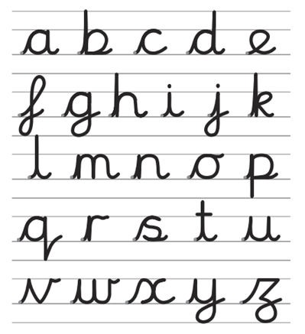
Handwriting
From Reception through to Year 6 we use the cursive handwriting style.
The aim of this style is to increase fluency and improve speed and presentation.
You will have access to the
website at home: http://www.letter-join.co.uk
Username: else
Password: nham
Notes:
A

Slide 10
Topics
Autumn
Science – animals and their habitats
History/ Geography – local history and geographical study of Elsenham
Spring
Geography – 7 Wonders of the World, country comparison.
History – Significant people in history (Rosa Parks and Emily Davison).
Science – everyday materials.
Summer
History – British seaside holidays, past and present.
Geography – country comparison – UK and The Caribbean.
Science – life cycles
Notes:
S

Slide 11
Time to Talk
Speaking aloud develops important oracy and presentation skills, as well as builds children’s confidence.
Please support your child to prepare a short presentation at home on a topic of their choice. This could be a hobby, an interest, a pet—anything they know lots about and enjoy talking about.
Please do not bring valuable or sentimental props!
Notes:
A

Slide 12
SATS
Non-statutory
In school assessments
Notes:
S

Slide 13
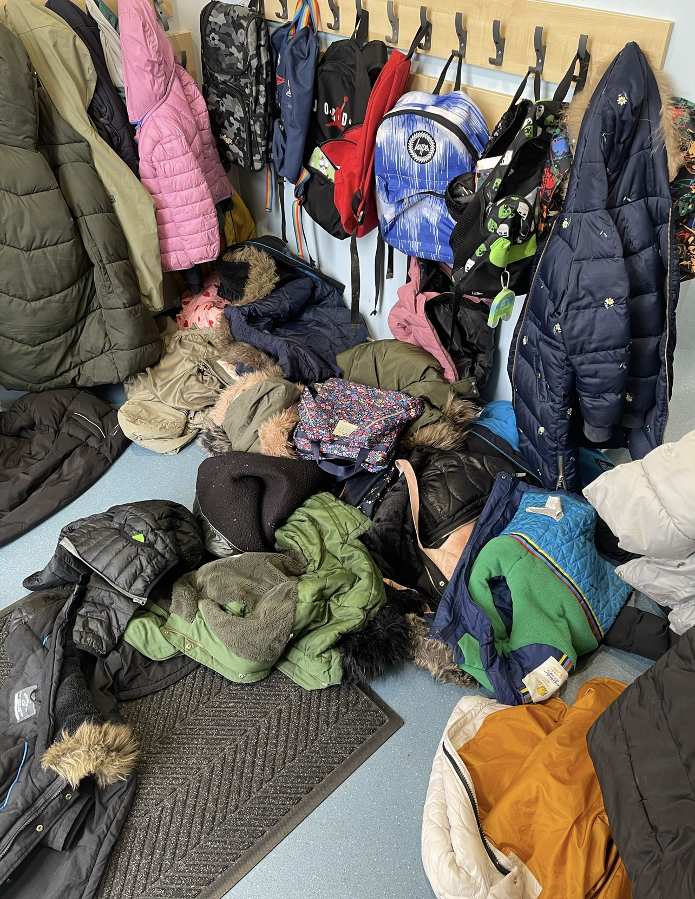
Cloakroom
We encourage book bags so our cloakroom doesn’t look like this
Make sure all coats are labelled
Notes:
A

Slide 14
Please help us by:
Naming all belongings and encouraging your child to look after their own things.
Sending your child to school in the correct uniform: earrings, plain hair clips that serve as a function.
Signing and commenting in Reading Records.
Supporting with topic homework projects.
Working on basic skills such as counting, numbers in digits and words, time telling and reading.
Notes:
S

Slide 15
Thank you for listening!
Are there any questions?
Notes:
A

